Slide 1
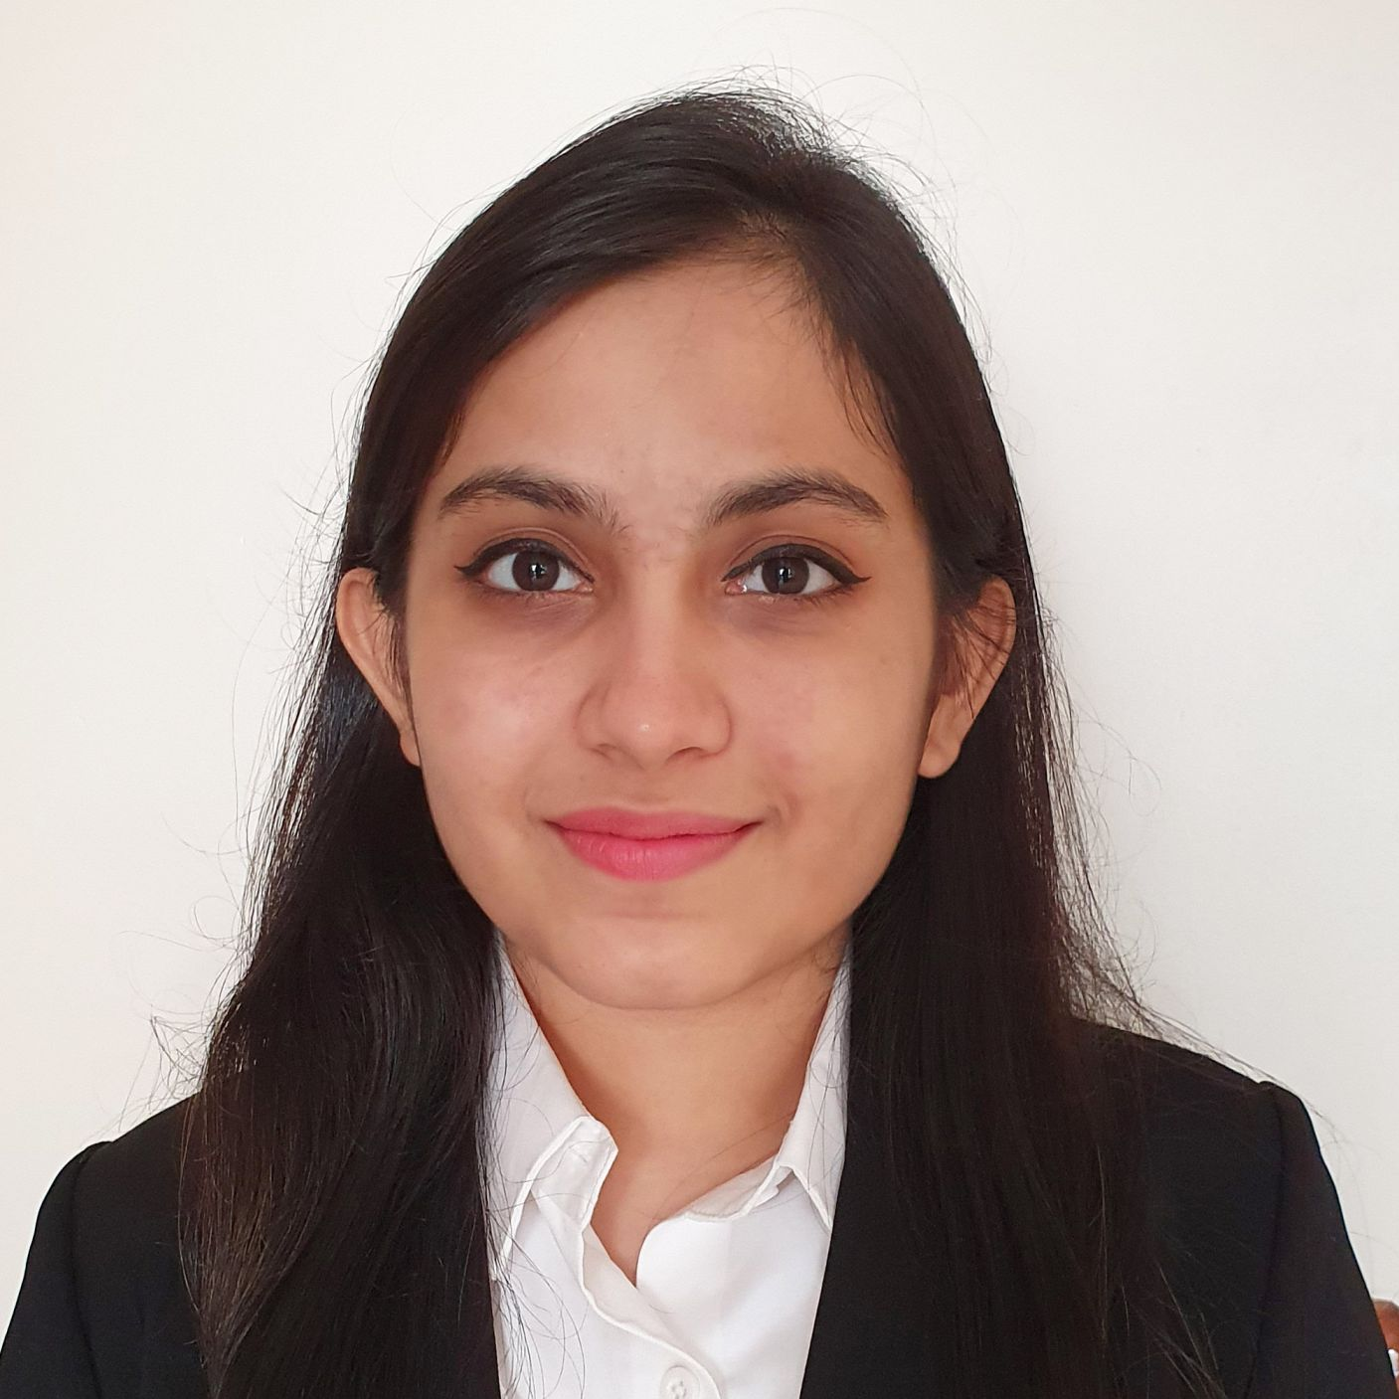



Bhargavi Sameep Kavalanekar
Analyst/Software Engineer
Bachelor of Engineering
Computer Science : 2017 - 2021
Skills
Java 8 /J2EE | Java Basics, OOPS, Generics, Collections, Arrays, Loops, Lambda Exp, Stream API Junit, Mockito, Servlets
Spring core | IOC & Dependency Injection
Spring REST | REST controllers, Implementation of GET, POST, PUT & DELETE, Bean Validation & Exception Handling, Testing Services, Controller & Repository layer
Spring Data JPA | Implement DAO layer using spring Data repositories, Transaction Management
Spring Boot Microservices | Spring Boot Starters, annotations, Swagger API documents
Spring Cloud | Eureka, Netflix Hystrix, Netflix Zuul & Config Server
Angular | Components, Services, Modules, Routing, Forms & Validation, Testing using Jasmine & Karma
Database | MongoDB No Sql Basics My SQL RDS Basics
UI Tech | HTML 5 & CSS 3,JavaScript, ES6 & TypeScript Reusable templates, Optimized UI Designed
Tools | Git, Postman, Maven, IDE
Add On skills | Communications, Team management. Peer learning
Mumbai
bhargavi-sameep.kavalanekar@capgemini.com
+91 9004674742
A4
Full Stack Developer
Hands on experience in creating microservices with Springboot, Spring Security, Spring Cloud API Gateway, Eureka server
Proficient in creating Single page Web Application in Angular with Authentication with route guards, Angular reactive forms, angular routing
Java Microservice Development knowledge using Spring boot and spring cloud framework on an intermediate level.
Team player who communicates effectively and works well with others to improve work output.
Eager to improve myself by learning new technologies and increasing my overall skills.
Coupons and Deals Finder Application
Completed end to end Coupons and Deal case study using Java Full Stack with Angular.
Implemented Multiple Micro services using Spring Boot and Spring Cloud and connecting them via a Discovery Server i.e. Eureka. Including routing using Netflix Zuul as a API Gateway.
Frontend with Angular 12, using Angular CLI for creating a user-friendly UI.
Backend with Mongo Compass.
Completed the i-Transform Java Full Stack Angular training
Check out my work on GitHub & Video Profile

Slide 2
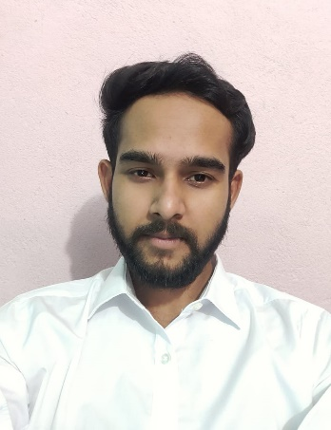
Raubins Raj
Analyst/Software Engineer
Bachelor of Engineering
Computer Science : 2016 - 2020
Skills
Bangalore
Java 8 /J2EE | Java Basics, OOPS, Generics, Collections, Arrays, Loops, Lambda Exp, Stream API Junit, Mockito, Servlets
Spring core | IOC & Dependency Injection, Autowire
Spring REST | REST controllers, Implementation of GET, POST, PUT & DELETE, Bean Validation & Exception Handling, Testing Services, Controller & Repository layer
Spring Data JPA | Implement DAO layer using spring Data repositories, Transaction Management
Spring Boot Microservices | Spring Boot Starters, annotations, Messaging Service, Sync/Async comms, Swagger API specifications
Spring Cloud | Eureka, Netflix Ribbon, Feign Client, Hystrix, Zuul & Config Server
React | Components, Hooks, Event handling, Redux, Reducers, Testing using Jasmin & Karma
Angular | Components, Services, Modules, Routing, Forms & Validation, Testing using Jasmin & Karma
Database | MongoDB No Sql Advanced My SQL RDS Basics
UI Tech | HTML 5 & CSS 3,JavaScript, ES6 & TypeScript Reusable templates, Optimized UI Designed
Tools | Git, Postman, Maven, IDE,PMD,Checkstyle
Devops | CI/CD, Jenkins configuration, Build Pipelines, notifications, quality gate understanding
Add On skills | Communications, Team management. Peer learning
xxxxxxxxxxx@capgemini.com
+91 xxxxxxxxxxxx
A4
MERN (Mongo, React, Express and Node) developer
Hands on experience in developing web pages using HTML5, CSS3, Object Oriented Java script, ES6, JQuery, AJAX, JSON, XML. Good understanding of Document Object Model (DOM) and DOM Functions.
Practical understanding of advanced Javascript concepts, such as Prototype, Closure, Scope Chain and Promise.
Proficient React developer with working knowledge on ReactJS(Hooks, redux).
Java Microservice Development knowledge using Spring boot and spring cloud framework on an intermediate level.
Implemented Nodejs and ExpressJs in case study and upskilling his knowledge continuously.
Experienced in practicing TDD based development using tools like Mockito, Junit, Istanbul and ensuring quality
E-Commerce Shopping Cart Application
Completed end to end case study of Shopping Cart Application along with JWT authentication, Swagger and payment testing using Braintree in MERN Stack. Material-UI and React Bootstrap used for user interface.
Online Bus Booking Application
Developed Online Bus Booking Application Using spring microservices and AngularJs with MYSQl as database in agile methodology of software development model.
HTML CSS JAVASCRIPT for web developers at Coursera
Completed this course with 98.6% and Designed responsive Restaurant website using HTML5 CSS3 Bootstrap and Javascript
Completed ”Build your first React website“ course at Coursera
Check out my work on GitHub & Video Profile

